Slide 1

Department of Computer Science & Engineering
Major Project Presentation-1
Project Title: Sign Language Recognition
GUIDED BY: PRESENTED BY:
Prof. Gagan Thakral Name: Riya Gupta, Priyanka
Anand, Khushboo Jha
Designation :
Assistant Professor Roll No. - 39, 15 , 51

Slide 2

content
Introduction
Literature Review
Problem Identification and Formulation
Project Objectives
Methodology/ Planning of work
Facilities required for proposed work
Expected outcomes
Current status of the Work
Analysis
Project screenshots
Working Module
References

Slide 3


Introduction
The goal of this project was to build a neural network able to classify which letter of the American Sign Language (ASL) alphabet is being signed, given an image of a signing hand.
Conversing with people having a hearing disability is a major challenge. Hence there is a need for systems that recognize the different signs and conveys the information to normal people.
Most research implementations for this task have used depth maps generated by depth camera and high-resolution images. The objective of this project was to see if neural networks are able to classify signed ASL letters using simple images of hands taken with a personal device such as a laptop webcam. This is in alignment with the motivation as this would make a future implementation of a real time ASL-to-oral/written language translator practical in an everyday situation

Slide 4
Literature Review
Abstract:
Sign language facilitates communication both within the community and between the deaf and the hearing. Sign language recognition can be used to ease the learning of sign language, or even to circumvent it altogether. Sign Language (SL) recognition is getting more and more attention of the researchers due to its widespread applicability in many fields. This paper is based on the survey of the current research trends in the field of SL recognition to highlight the current status of different research aspects of the area. Paper also critically analyzed the current research to identify the problem areas and challenges faced by the researchers.
Introduction:
Sign Language is important, but learning languages is difficult. For this reason, computers and various input devices have been applied to create the field of automatic sign language recognition (SLR). Over the last several years, the scene of the hand gesture recognition field has changed due to the emergence of several depth-based devices. This paper will focus on reviewing the.

Slide 5
Cont..
literature concerning the use of the American Sign Language (ASL), alphabet is being signed, given an image of a signing hand. ASL (American Sign Language) is a natural language that serves as the predominant sign language of Deaf communication in the United States of America and most of Anglophone Canada
ASL is a complete and organized visual language that is expressed by both manual and nonmanual features. The chosen methods and their results will be compared in order to find the most successful approaches. A wide selection of research about the hand gestures in different languages has been done in relation to sign language recognition is available. This paper will contain information about various algorithms and techniques used in word formation by hand gestures recognition.
USE OF MACHINE LEARNING:
The use of machine learning helps overcome several difficulties. Various algorithms have been tried and tested. Classification machine learning algorithms like SVM, k-NN are used for supervised learning, which learning, which involves labelling the dataset before feeding it into the algorithm for training. For this project, various classification algorithms have been studied and used like SVM, RNN, k-NN, and CNN.

Slide 6
Cont.
RESULTS:
Broadly, the literature deals with feature extraction, and gesture classification. A variety of both variables have been used in the literature. As mentioned previously, the data set generally consisted of some fingerspelling gestures, and the testing was done using some form of cross validation. By considering the real time scenario, the software aims to present a real time system for recognition of hand gesture on basis of detection of some shape-based features like orientation. Centre of mass centroid, finger status, thumb in positions of raised or folded fingers of hand.

Slide 7
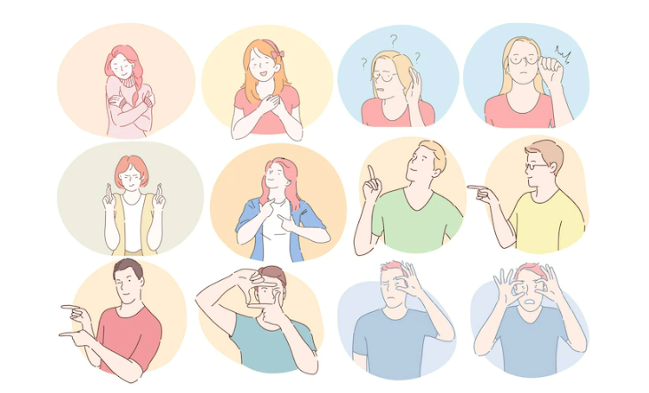
Objectives
Communication is always having a great impact in every domain and how it is considered the meaning of the thoughts and expressions that attract the researchers to bridge this gap for every living being.
The objective of this project is to identify the symbolic expression through images so that the communication gap between a normal and hearing-impaired person can be easily bridged.
To develop an automatic sign language recognition system with the help of image processing and
computer vision techniques.
The objective for this work is to provide a real time interface so that signers can easily and quickly communicate with non-signers.
To efficiently and accurately recognize signed words, from Sign Language, using a minimal number of training examples

Slide 8
Methodology/ Planning of work
The primary source of data for this project was the compiled dataset of American Sign Language (ASL) called the ASL Alphabet. Tools of data collection / analysis
Uses dynamic dataset fort training. dynamic is a real-time live capture of the gestures. This involves the use of the camera for capturing movements.
Programming an AI to Recognize Sign Language with TensorFlow and Keras
Backend language: Django
With Django, you will get authentication, URL routing, template engine, object-relational mapper (ORM), and database schema migrations all in one pack.
Frontend language: HTML, CSS, JavaScript

Slide 9
Facilities required for proposed work
Software requirements:
1)Operating System:
• Windows
2)SDK:
• Python (3.7.4) IDE (Jupyter), cv2 (OpenCV) (version 3.4.2)
• TensorFlow, Eros, NumPy (version 1.16.5), Keras (version 2.3.1), TensorFlow (as keras uses TensorFlow in backend and for image preprocessing) (version 2.0.0) , VS Code
Hardware Requirements: The Hardware Interfaces Required are:
• Camera: Good quality,3MP • Ram: Minimum 8GB or higher
• GPU: 4GB dedicated • Processor: Intel Pentium 4 or higher

Slide 10
Expected outcomes
Our project aims to capture sign language performed by signers on a real-time basis and interpret the language to produce textual output for the illiterate.
For this, a camera-based approach will be made use of, owing to the ease of portability and movement that the camera based method offers over other technique

Slide 11
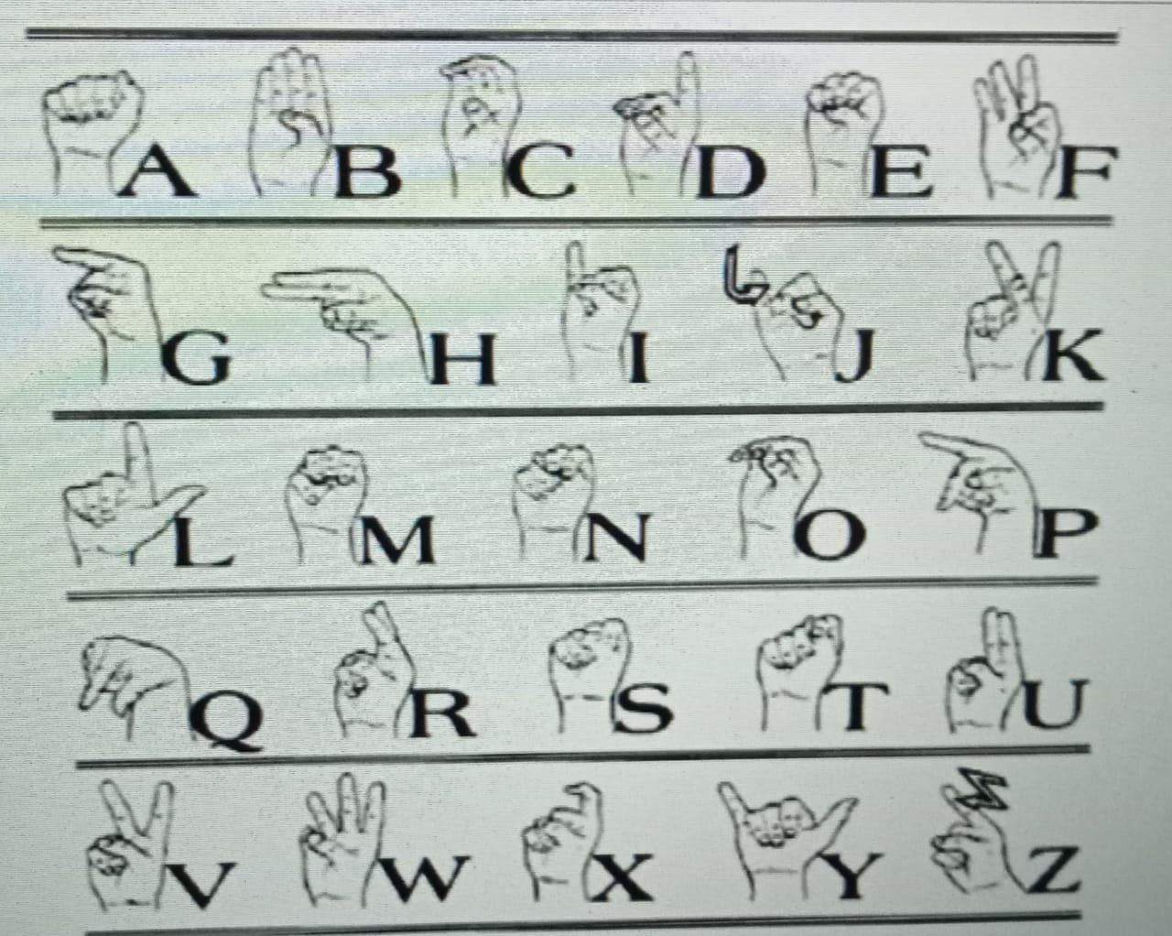
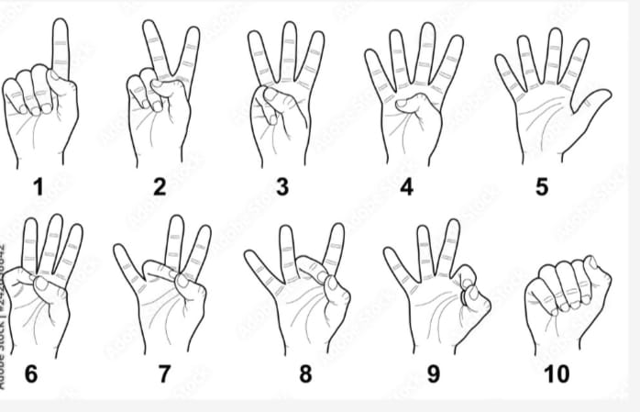
Dataset Alphabets & Numeric Values

Slide 12
References
https://www.researchgate.net/publication/314522980_Sign-Lingo_-Feasibility_of_a_Serious_Game_for_Involving_Parents_in_the_Language_Development_of_Their_Deaf_or_Hearing_Impaired_Child - [Ivor van der Schalk and Marco Spruit , Department of Information and Computing Sciences, Utrecht University, Utrecht, The Netherlands, January 2017]
https://ijisrt.com/assets/upload/files/IJISRT21APR505.pdf- [Ayushi N. Patani, Varun S. Gawande, Jash V. Gujarathi, Vedant K. Puranik, Tushar A .Rane Department of Information Technology Society for Computer Technology and Research’s Pune Institute of Computer Technology Affiliated to Savitribai Phule Pune University (formerly known as Pune University ) , April 2021]
https://ieeexplore.ieee.org/document/9681062- [Qazi Mohammad Areeb; Maryam; Mohammad Nadeem; Roobaea Alroobaea; Faisal Anwer , January 2022]
https://ieeexplore.ieee.org/document/9835908-[Vishal Munnaluri; Vishal Pandey; Parminder Singh , July 2022]
https://ieeexplore.ieee.org/document/7507939 - [Anup Kumar; Karun Thankachan; Mevin M. Dominic , July 2016]

Slide 13
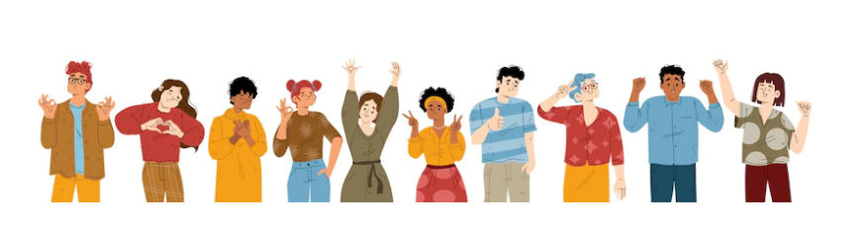
THANKYOU…

